Slide 1


Shaftesbury Junior School
Let’s go!
Headline sponsor

Slide 2
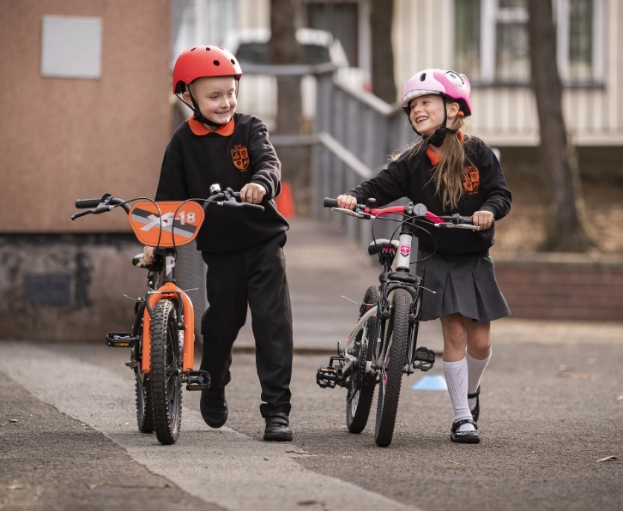

Eco Warriors
Big Walk and Wheel week: What is it?
Sustrans Big Walk and Wheel is the UK’s largest walking, wheeling, scooting and cycling to school challenge.
© 2021, Brian Morrison

Slide 3
Why are we taking part?
Travelling actively is great exercise and helps us stay healthy!
Travelling actively to school means we arrive more alert and ready to learn!
Walking, wheeling and scooting to school is fun!
More people travelling actively to school means cleaner air, less traffic and less noise around the school.
We can win prizes!

Slide 4

Why are we taking part?
We want to be part of something BIG!
By taking part, we will learn about how changing our school journey can help us change our world for the better!

Slide 5
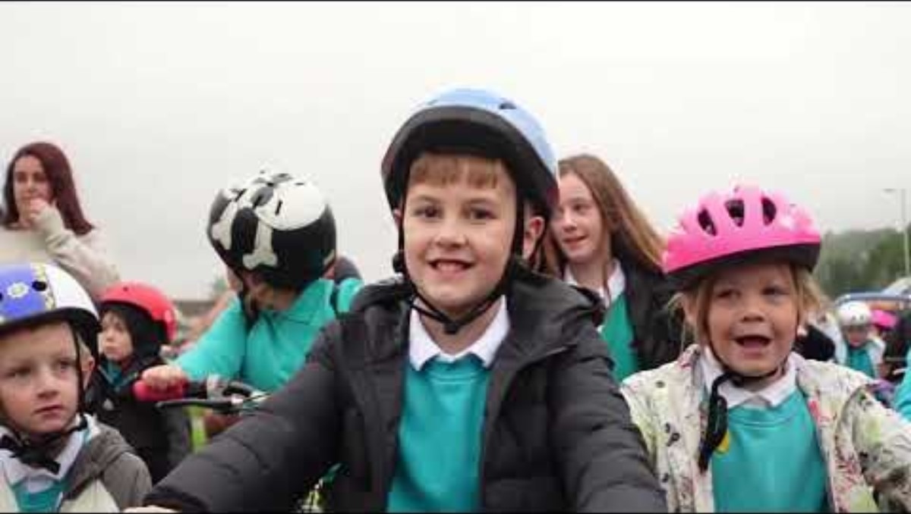
Did You Know?
Last year the Sustrans Big Walk and Wheel challenge helped avoid just over 1,700 tonnes of CO2 and just over 2,500 kg NOx emissions**
Watch this short video…
Let’s learn how we can help make change happen together!
Notes:
**If the children taking active journeys during Sustrans Big Walk and Wheel had travelled to school by car instead
We are aware some children experience eco-anxiety (also known as eco-distress). This Royal College of Psychiatrists webpage is for parents and carers, teachers and others who support children and young people Eco distress and eco anxiety resources for parents. It explains what eco distress is, how to recognise if a child is experiencing eco distress, and provides suggestions to help children cope with their feelings.

Slide 6


