Slide 1
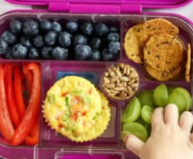
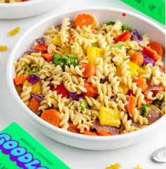
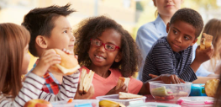
On Mondays it will be meat free for pack lunches and dinners

Slide 2
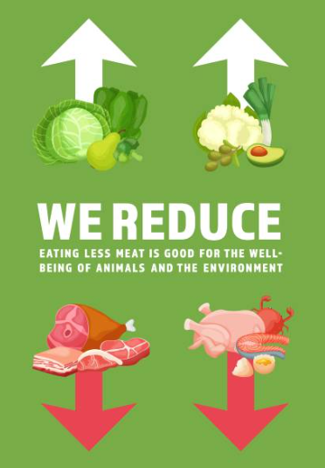

Slide 3
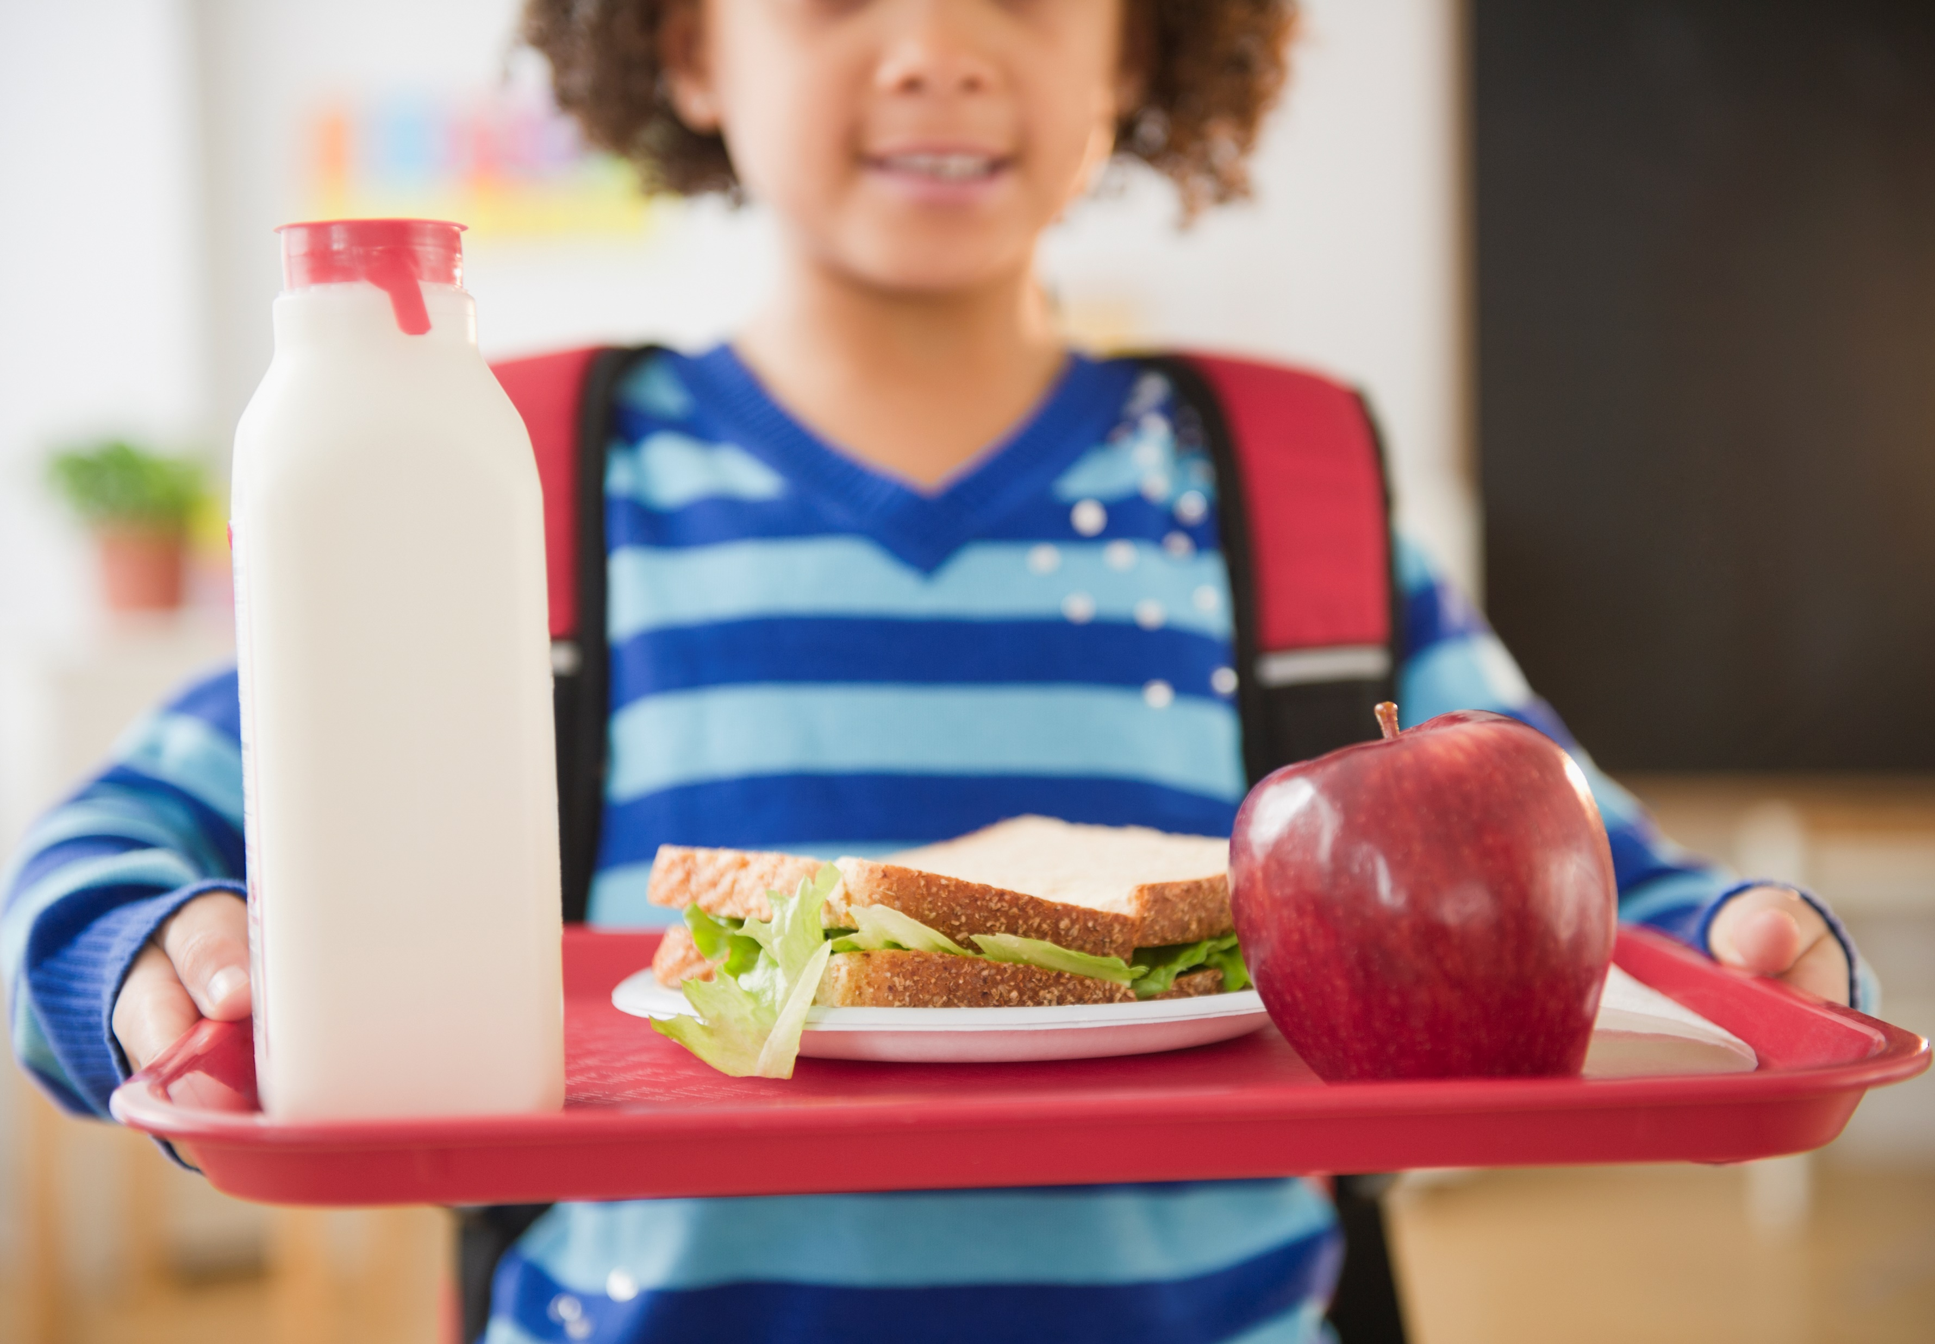

Slide 4
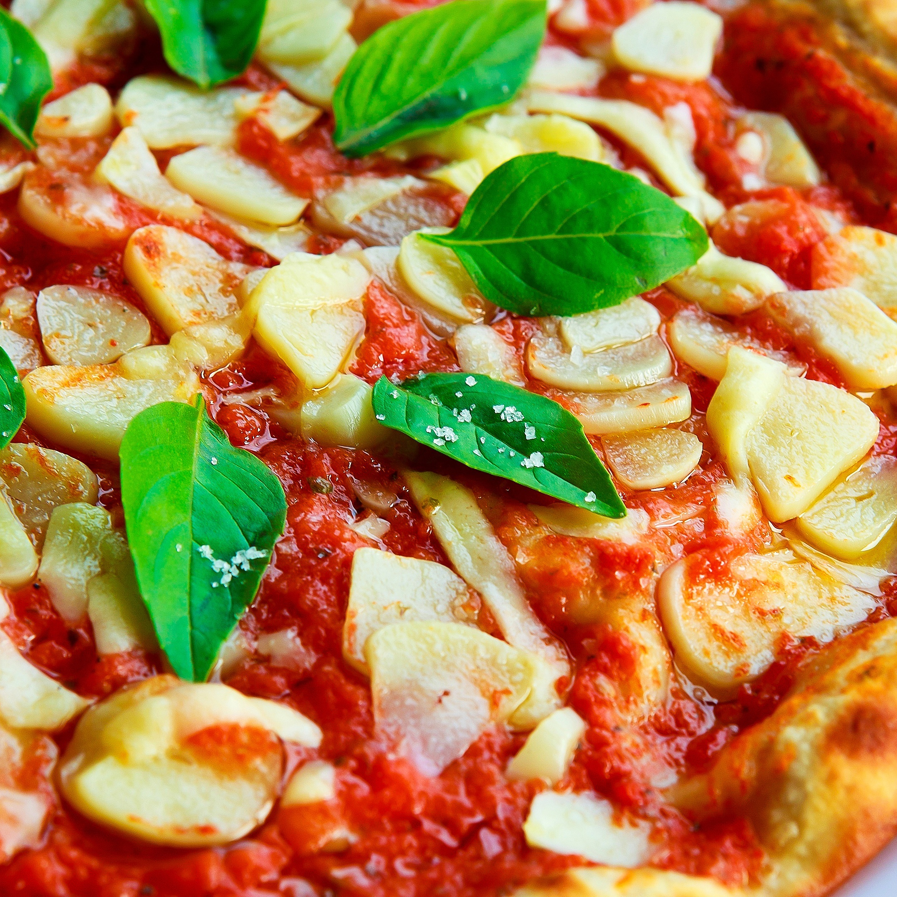
Pizza is one of a meat free foods but no bacon or pepperoni, instead you can have margherita.

Slide 5
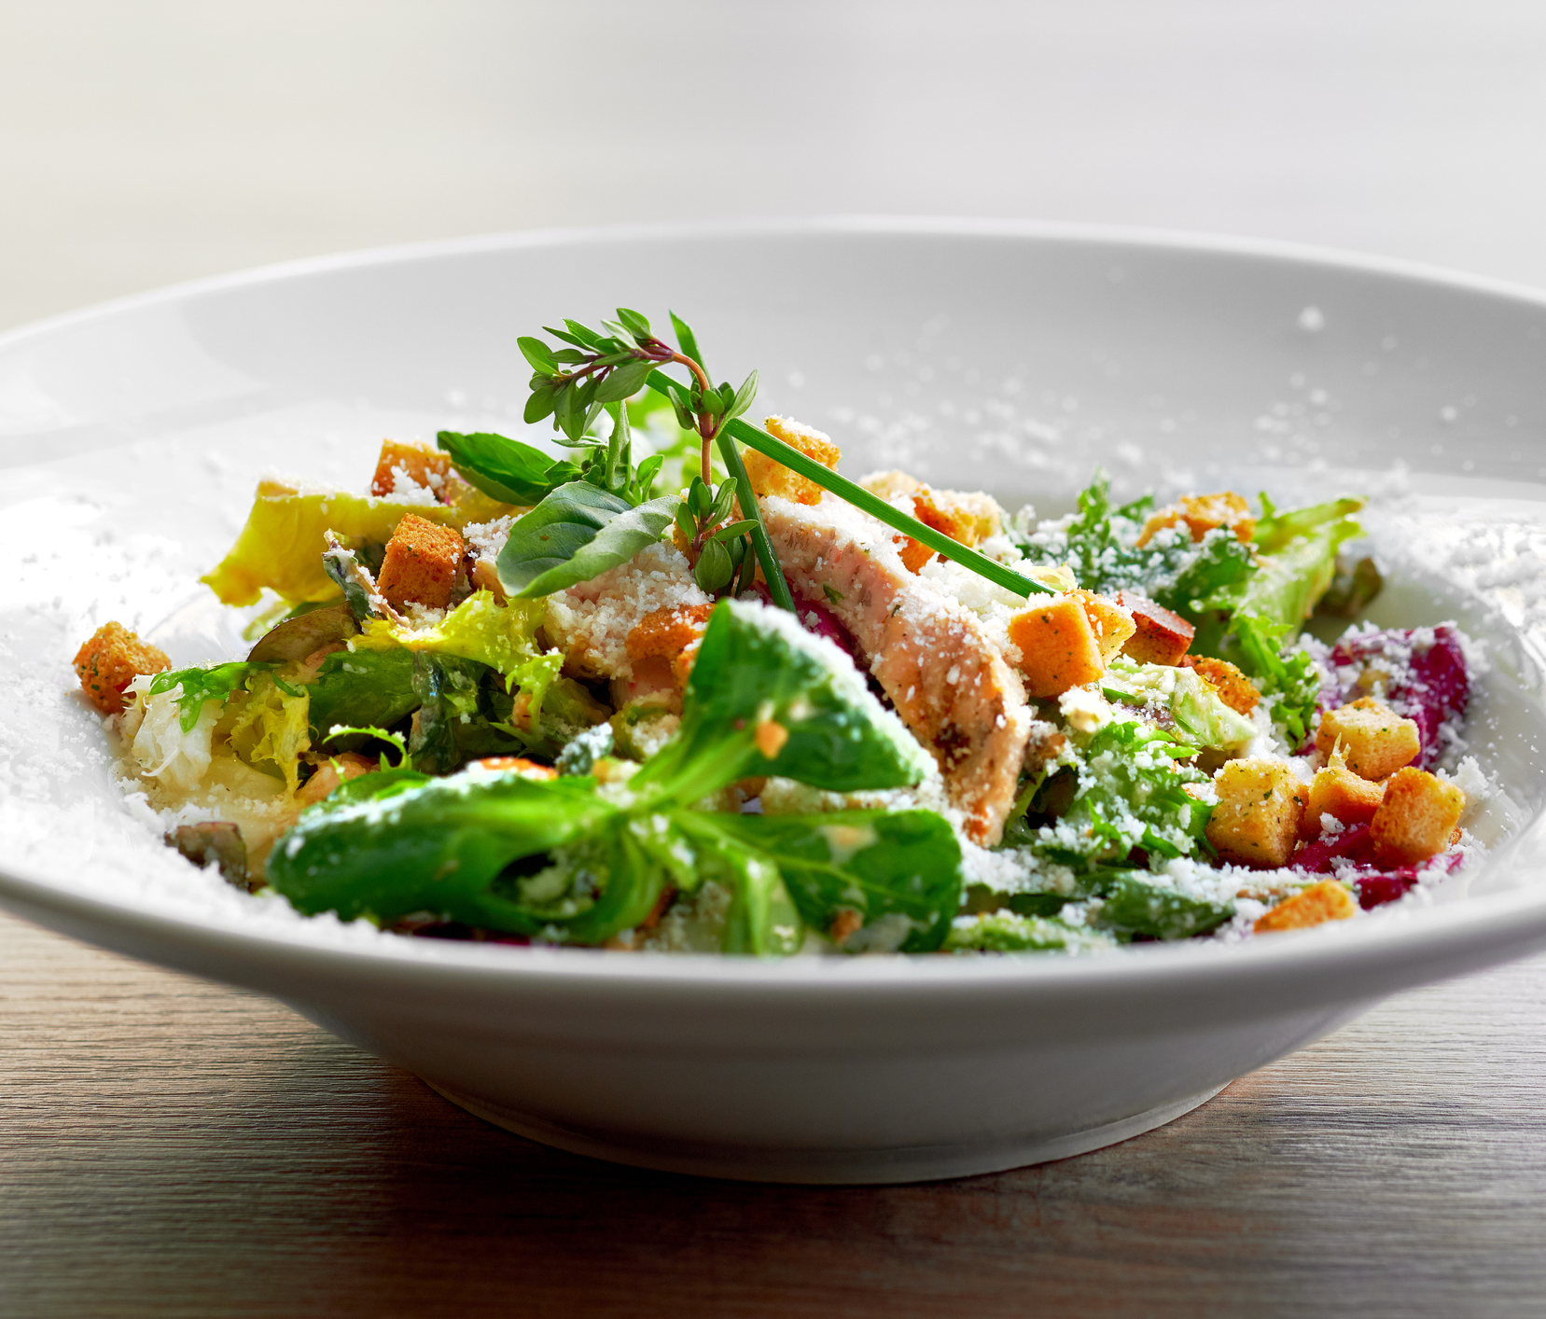
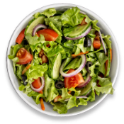
Or maybe a salad

Slide 6
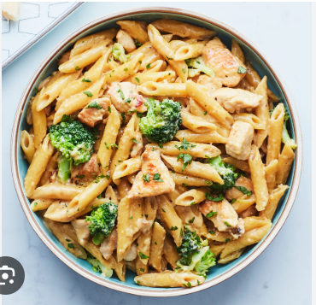
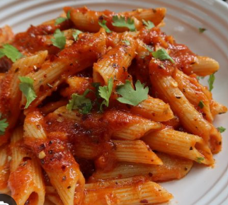
Or if you like pasta

Slide 7

Or boiled eggs, omelettes. Plus, they are high in protein

Slide 8


