Slide 1
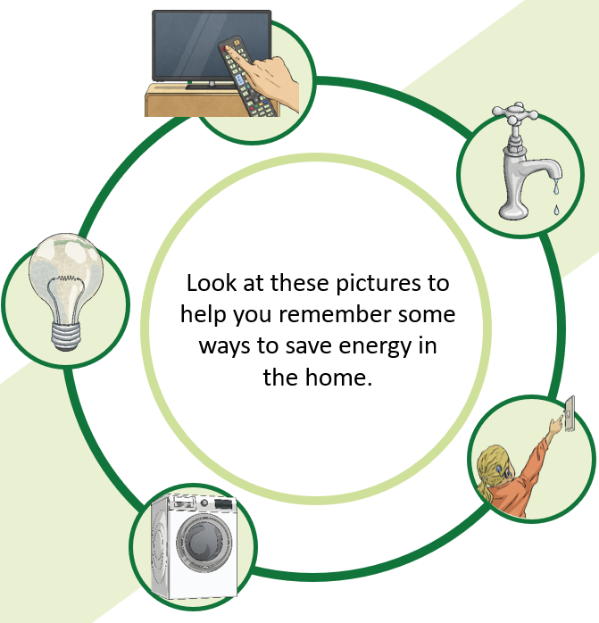
SJS Save energy monitoring- Spring term
4S - 4
4K - 8
3J – 9
5P – 9
3W - 10
6S - 10
6P – 10
5G – 12

