Slide 1

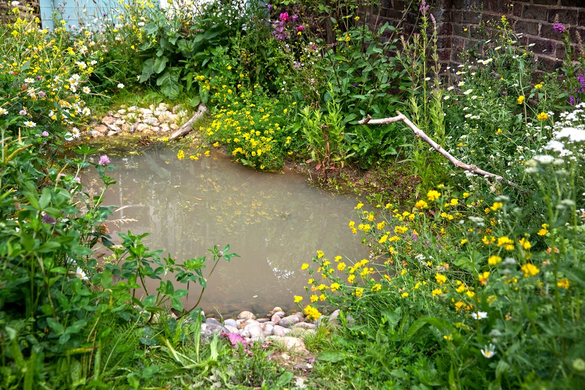
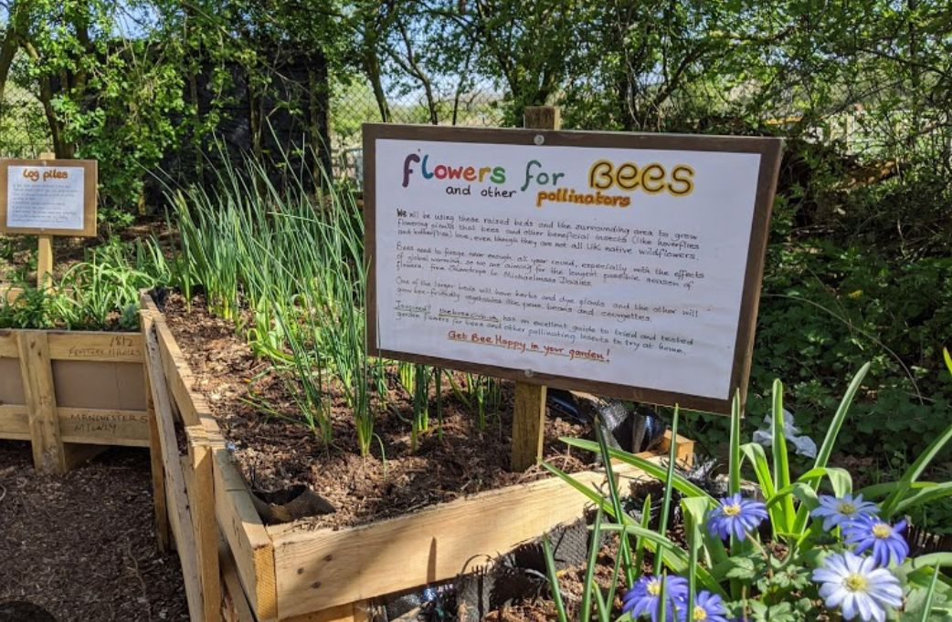
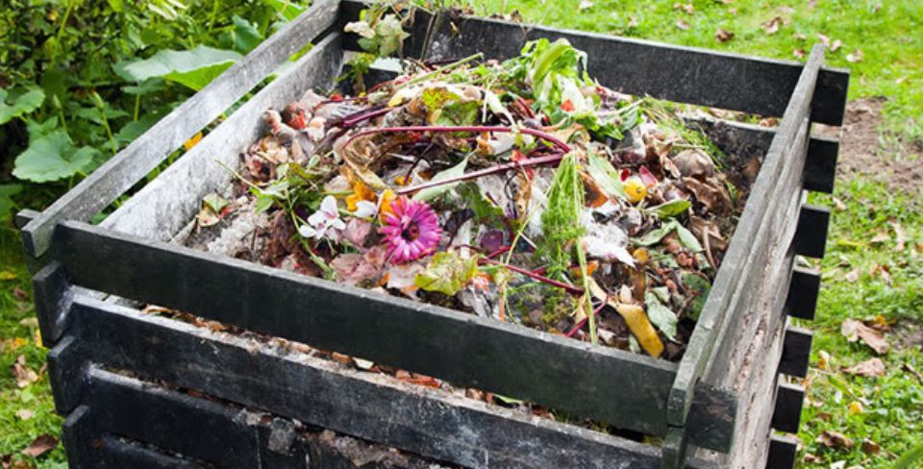
Biodiversity
Flower beds Pond Compost bin
Could you have these in your garden?

Slide 2
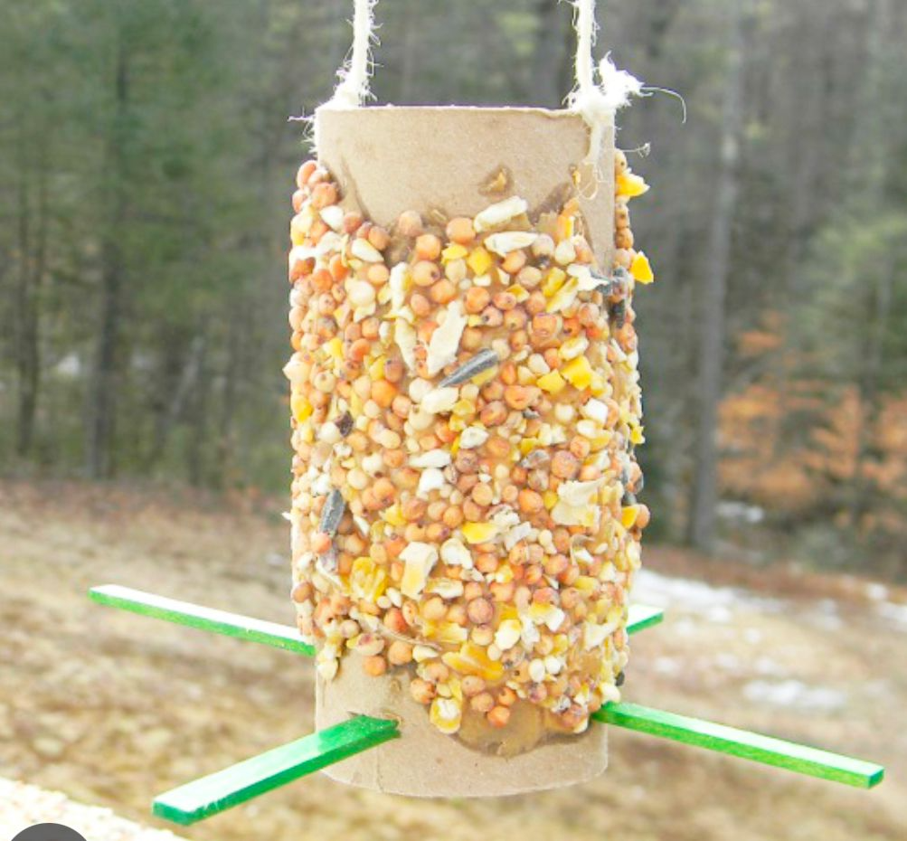
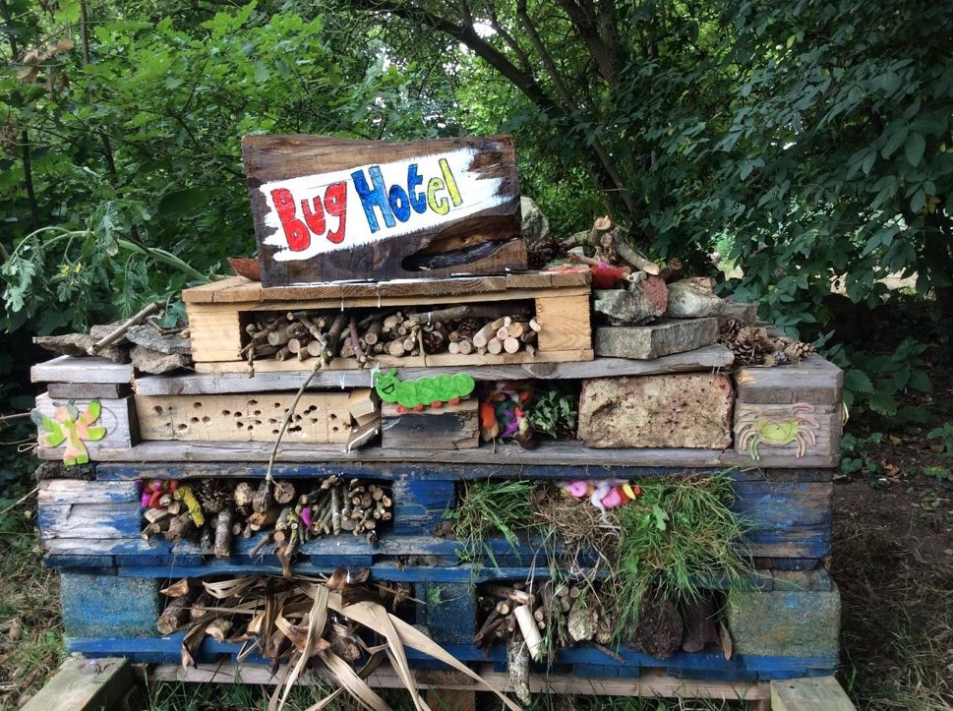
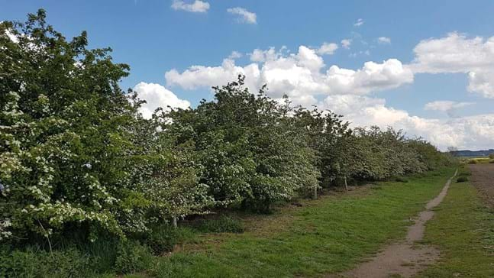
Biodiversity
Bird feeders Bug hotels Hedgerows
Could you have these in your garden?
Notes:
Explore nature grants from you local wildlife trusts
Another good organisation is Learning through Landscapes – Local School Nature Grant

Slide 3
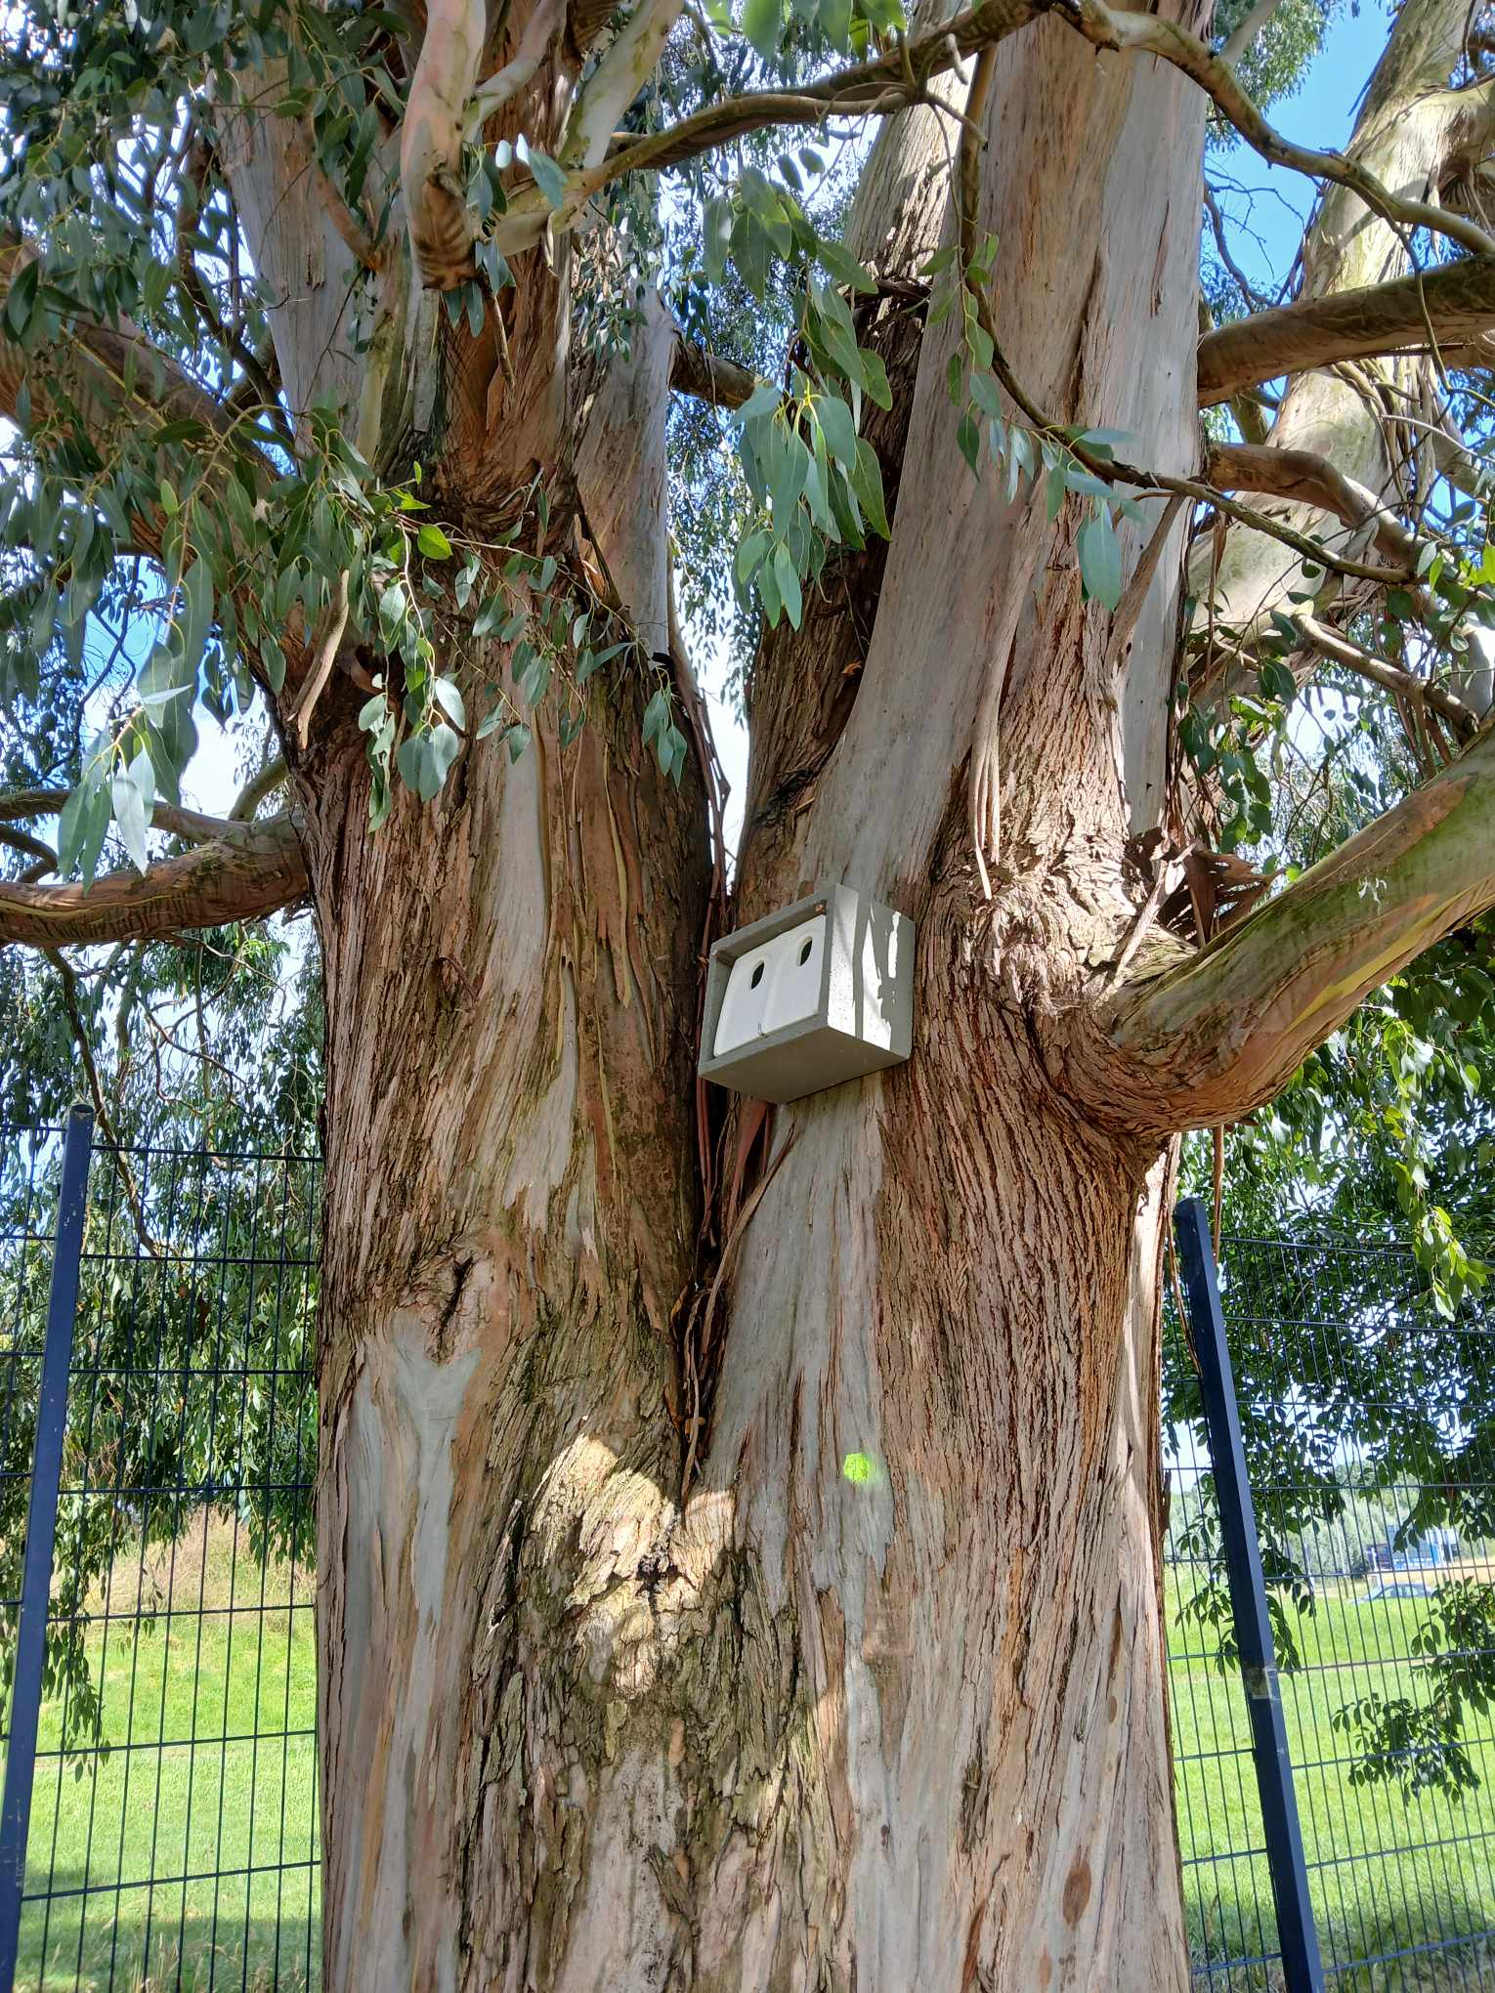
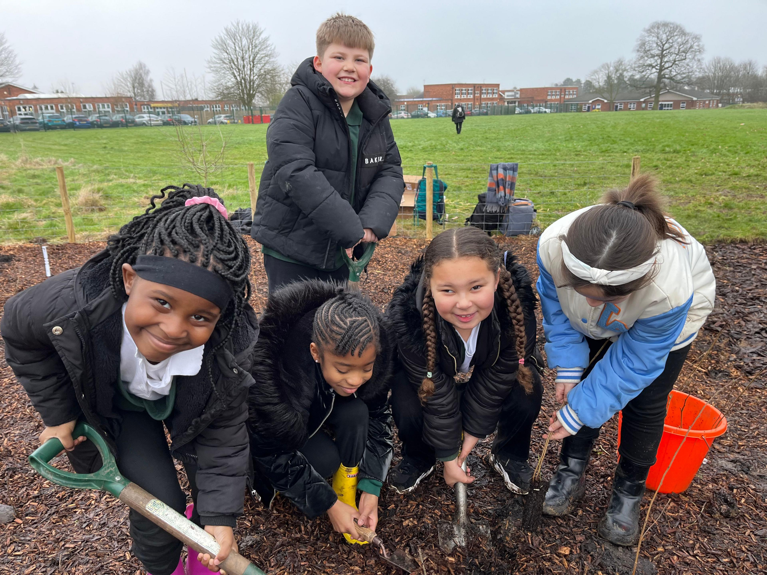
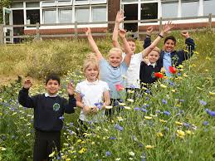
Biodiversity
Meadow Tiny Forest Nest boxes
Could you have these in your garden?
Notes:
Explore nature grants from you local wildlife trusts
Another good organisation is Learning through Landscapes – Local School Nature Grant

Slide 4
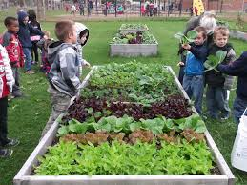
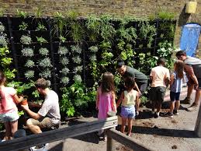
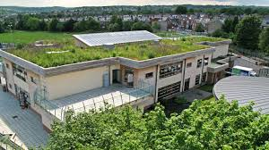
Biodiversity
Vegetable area Green wall Green roof
Could you have these in your garden?

Slide 5
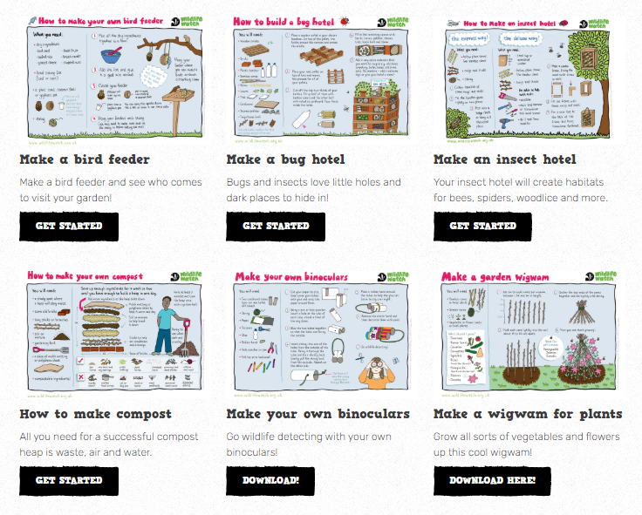
Biodiversity
Individual and Family Actions
There's lots of great ideas for families to help wildlife here on
the Wildlife Watch Website.

